Slide 1


“Capstone Project”
Submitted by: Adarsh Verma
Submission type : Individual
Name: Adarsh Verma
Batch : B1
LMS Id : adarshverma8u@gmail.com
Program : HDFC API Developer
Guided By: Javeed Sir
Date: DD/MM/YYYY

Slide 2

Table of contents
Introduction
Project Overview
Architecture Design
User Interface Design
Back-end Development
Front-end Development
Testing
Deployment
Conclusion
Future Work
References
Appendices

Slide 3
Introduction
The project aims to develop a web service for managing employee records. The web service will allow users to search employee records based on EmployeeID, and it will be accessible through HTTP and HTTPS protocols. The system will use encryption to protect sensitive employee data. It will also maintain log of the user entry which will be stored in a backup space. The web service can be accessed using different means.
Problem Statement: The task is to build a system for tracking employee information, it should be secure and can be accessible using different ways. This system should be containerized and should perform continuous integration and deployment upon it using an automation tool .
Research Question: How can we develop a web service that allows organizations to manage employee records efficiently while ensuring the security and privacy of sensitive employee data and also perform continuous integration, testing and deployment upon it?

Slide 4
Introduction
Objectives:
To develop a web service that allows organizations to manage employee records efficiently.
To ensure that the web service is secure and protects sensitive employee data using encryption.
To provide users with easy access to employee records through HTTP and HTTPS protocols.
To perform continuous integration ,testing and deployment on it.
Importance and Relevance:
The project is important because it addresses the need for a centralized system for managing employee records. By providing a secure and efficient web service, organizations can reduce data redundancy, ensure data consistency, and improve productivity. Additionally, the use of encryption protects sensitive employee data from unauthorized access, ensuring compliance with data protection regulations. The project is relevant to organizations of all sizes and across different industries.

Slide 5
Project Overview
The system is built using the Java programming language and the Springboot framework. It is deployed on a integrated Tomcat application server and uses a MySQL database to store employee records. The code is stored in a GIT repository, and changes are deployed automatically using Jenkins. AES-256 encryption is used to protect sensitive employee data. Finally, the system is containerized using Kubernetes, ensuring that it can be easily scaled and deployed across different environments.
Key Features:
Fetch employee records based on EmployeeID
Secure access through HTTPS protocols
Encryption to protect sensitive employee data using AES-256
Making record of logs on the basis of responses
Containerizing web request on Docker and deploying it in kubernetes
Functionality: The system provides a centralized location for managing employee records, making it easy for organizations to track employee information. Users can quickly query employee records based on EmployeeID, ensuring that the correct data is returned. The system also provides secure access through HTTP and HTTPS protocols, ensuring that sensitive employee data is protected.

Slide 6
Project Overview
Technology Stack:
Java programming language
Spring boot framework
Tomcat Imbedded server
MySQL database
GIT repository
Jenkins for continuous deployment
AES-256 encryption algorithm
Kubernetes containerization technology

Slide 7
Architecture Design
The application consists of a back-end implemented in Java using Spring Boot or an application server such as Tomcat or WebLogic. The back-end interacts with a database that contains a single table called "Employee" with three columns: "EmployeeID", "EmployeeName", and "DateOfBirth".
The back-end exposes a REST API that allows users to query the "Employee" table based on the "EmployeeID" column. If the requested "EmployeeID" is not found, an error message is returned. The REST API logs every call to the service with a date-timestamp and implements log rotation to manage the size of the log file.
The application is deployed using Jenkins, which automates the deployment process to the application server.
The back-end is modified to expose the REST API over HTTPS using a self-signed certificate. The REST API is tested using Postman and a separate Java client program.
The "DateOfBirth" column in the "Employee" table is encrypted using AES-256. The back-end is updated to handle encryption and decryption of the "DateOfBirth" column. The client program is also updated to handle decryption of the encrypted "DateOfBirth" value.
The application is containerized using Docker, and the containerized version is deployed on Kubernetes. The client program is used to call the containerized version of the web service, which is scaled to run on three instances.

Slide 8
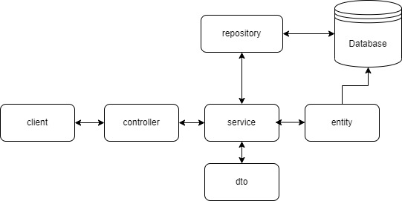
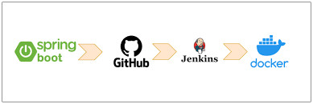
Architecture Design
Web Service Architecture
Project Architecture

Slide 9
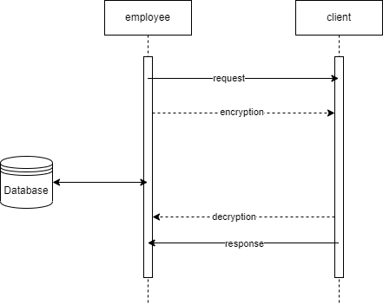
User Interface Design

Slide 10
Back-end Development
Created an Employee table with EmployeeID, EmployeeName, and DateOfBirth columns in a database using SQL.
Write Java code to query a single Employee record based on the EmployeeID and deploy it to an application server such as Tomcat.
Expose the Java code as a HTTP web service and configure it to print a log file with date-timestamp for every call made to the service.
Implement HTTPS for the web service using a self-signed certificate and test it using Postman and CURL commands, and update the client program to decrypt the encrypted value of the DateOfBirth field.
Containerize the web service and deploy it on Kubernetes with 3 instances running.

Slide 11
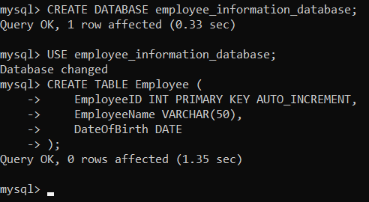
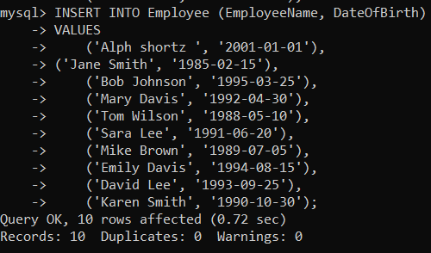
Back-end Development

Slide 12
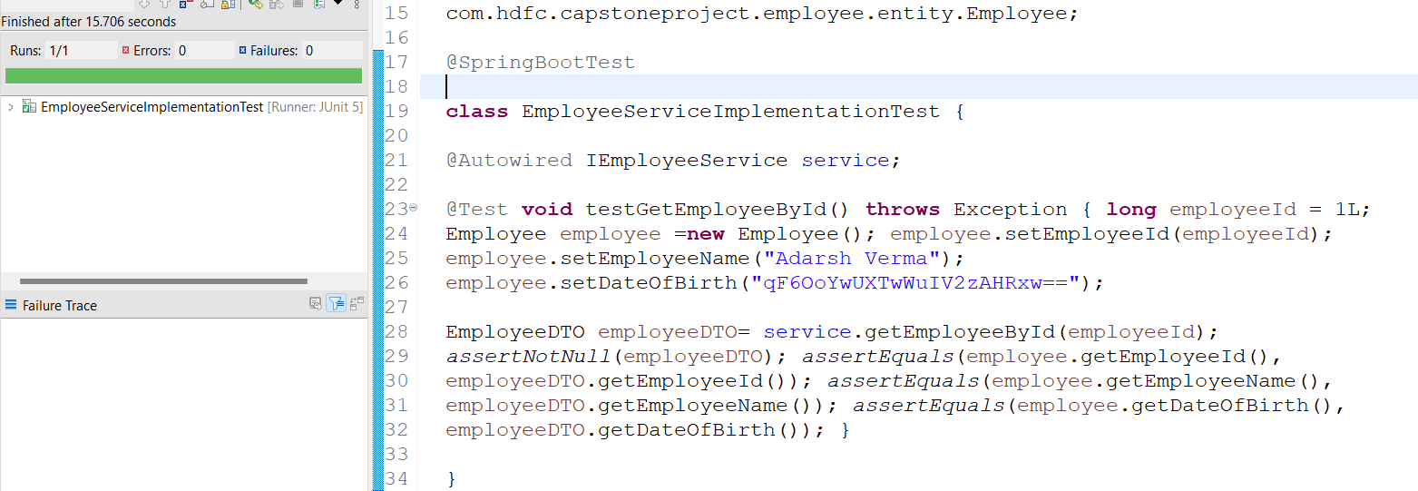
Integration and Testing
Unit tests were used to test individual components of the application in isolation.
Integration tests were performed to test the interactions and integration between different components of the application.
Automated testing tools such as Junit were used to execute the tests.
Continuous Integration (CI) was implemented using Jenkins, ensuring that all tests were run automatically every time code changes were made, to detect issues early in the development process.

Slide 13
Deployment
This project involves developing and deploying a web service to fetch employee information from a database using Java and Springboot. The code is stored in a Git repository and deployed to an application server using Jenkins.
The service is exposed as an HTTP web service that logs each call with a date-timestamp, and uses AES-256 encryption to encrypt the DateOfBirth field. It is later updated to use HTTPS with a self-signed certificate.
The service can be called using Postman, a CURL command, or a separate Java client program that decrypts the encrypted DateOfBirth field. The final step involves containerizing the service and deploying it on Kubernetes with three instances.
The deployment process involves configuring the hosting platform, setting up the necessary environment and dependencies, and deploying the containerized application.

Slide 14
Conclusion
The project involves creating an Employee table with three columns in a database and developing Java code to query a single record based on EmployeeID. The code is deployed using Jenkins and exposed as an HTTP web service that logs every call made to it. The web service is then modified to support HTTPS and a self-signed certificate is used. A curl command and Java client program are created to call the web service, which is updated to encrypt the DateOfBirth field using AES-256. The web service is containerized and deployed on Kubernetes with three instances running.
The project faced significant obstacles while implementing HTTPS and encryption. However, the I was able to overcome these challenges by conducting thorough research and implementing best practices. Other challenges, such as implementing containerization, were also resolved through appropriate solutions.
Overall, the project involved technologies such as Java, Springboot, Tomcat, Jenkins, Postman, AES-256 encryption, Docker, and Kubernetes.

Slide 15
Future Work
The given project requirement provides a basic foundation for building a functional web service for retrieving employee data. However, there is always room for improvement and expansion. For example, additional features such as the ability to update or delete employee records can be added to the web service.
Enhancements such as adding input validation to ensure that the employee ID is in the correct format and within a valid range can improve the user experience.
Enhancements to security could also be considered, such as using a certificate from a trusted third-party rather than a self-signed certificate.
Additionally, integrating with front end technology can be considered to improve the overall functionality and user experience of the application.

Slide 16
References
https://github.com/javeed512/HDFC_JAVA.git
https://howtodoinjava.com/log4j2/log4j2-tutorial/
https://www.youtube.com/watch?v=SbuPNXXvTJA
https://youtu.be/SONEaty1ydk
https://docs.docker.com/
https://kubernetes.io/docs/home/

Slide 17
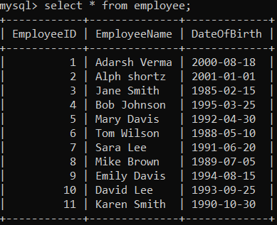
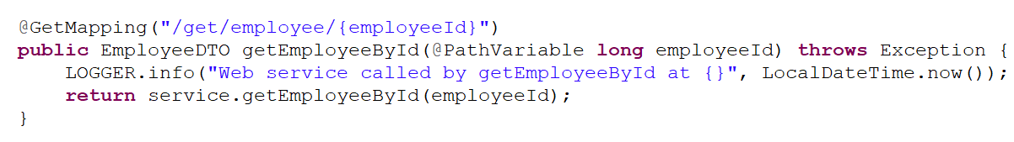
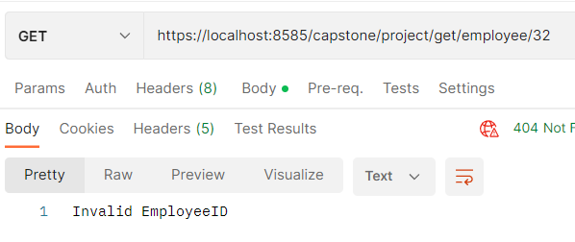
Appendices
Create a table Employee with 3 columns (EmployeeID, EmployeeName, DateOfBirth) in a database.
Write programming language code (preferably in Java) to query a single record based upon EmployeeID. This code should run from Springboot or an Application server such as Tomcat, WebLogic, etc.
Invalid EmployeeID Error should be returned if EmployeeID is not matched.

Slide 18
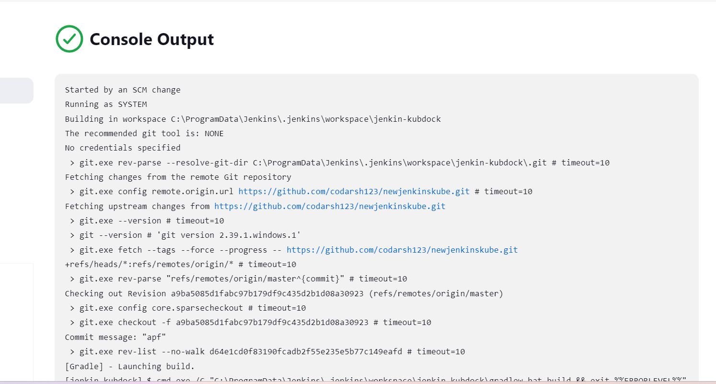
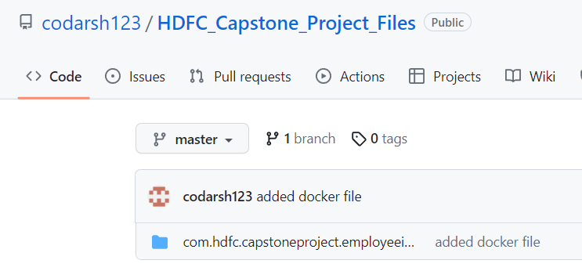
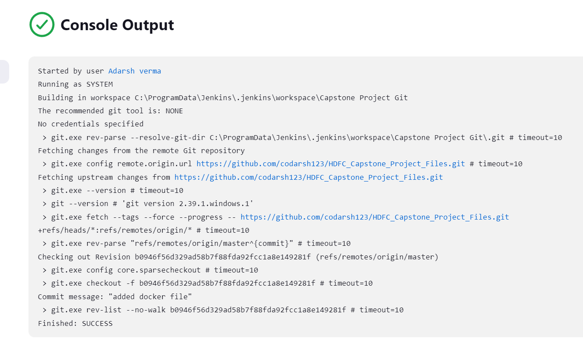
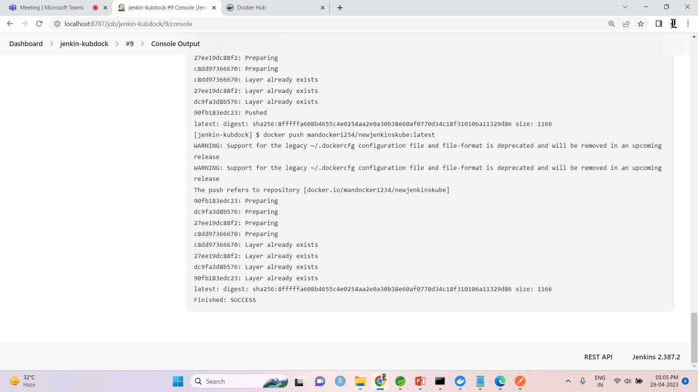
Appendices
Ensure code is checked into a repository such as GIT or equivalent.
Use Jenkins to deploy changes to the code to the Application server.

Slide 19
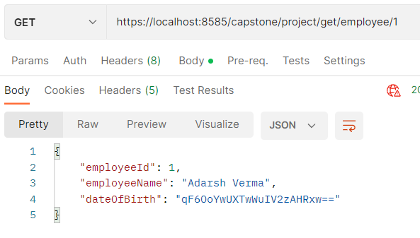
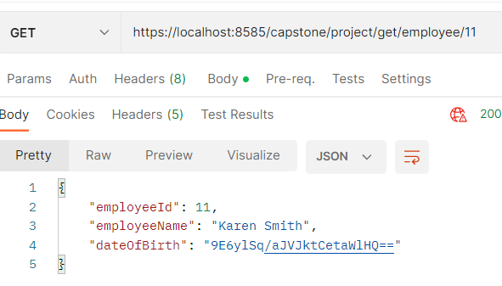
Appendices
Modify the Java (or equivalent) code so that it is exposed as a HTTP web service. The request should accept a single EmployeeID while the response should have all three fields of that Employee i.e., EmployeeID, EmployeeName, DateOfBirth.
Call this web service from PostMan.
Change this web service so that it is exposed as HTTPS and not HTTP. Use a self-signed certificate. Re-test from Postman.
Update the code of the web service so that DateOfBirth is encrypted using AES-256.

Slide 20
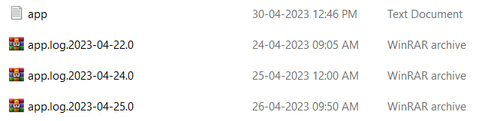
Appendices
Web service should print a log file with date-timestamp for every time it is calls. In case size of log exceeds 1 MB, the log file should get rotated i.e., existing file should be backed up, new log file should be utilized.
Write a CURL command to call this web service.

Slide 21
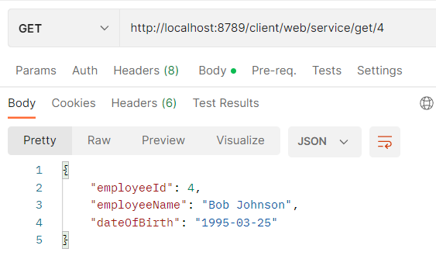
Appendices
Write a separate Java (or equivalent) client program to call this web service.
Update the client program to decrypt this encrypted value.

Slide 22
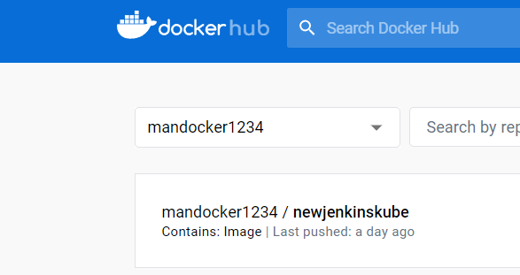
Appendices
Create a containerized version of the web service.

Slide 23
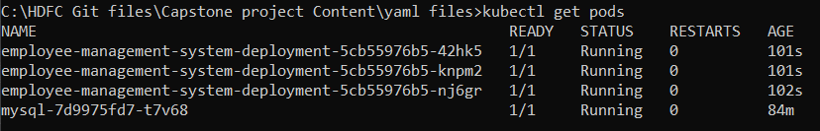
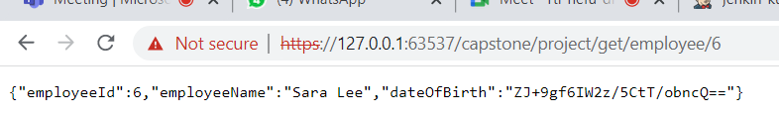
Appendices
Deploy this container on Kubernetes, with 3 instances on the container running. The same/similar client program should be utilized to call this containerized version of the web service.

Slide 24
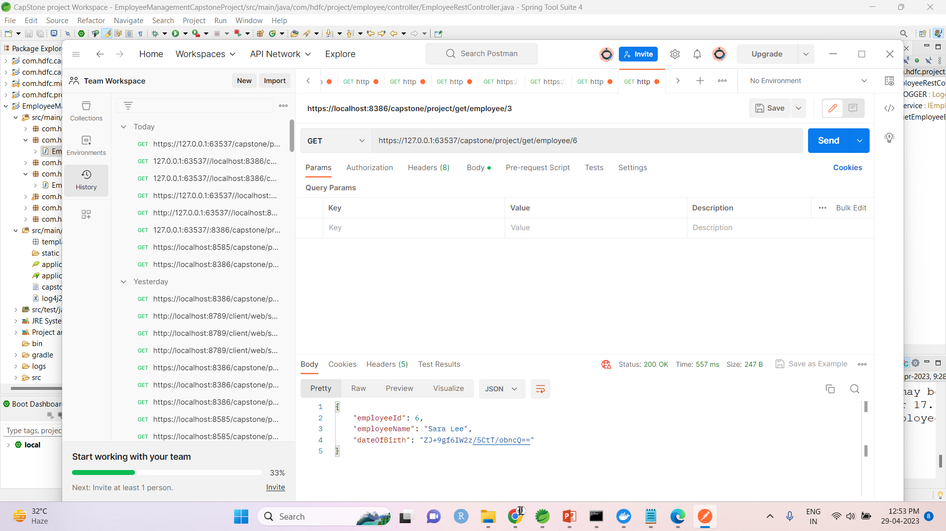
Appendices
Deploy this container on Kubernetes, with 3 instances on the container running. The same/similar client program should be utilized to call this containerized version of the web service.

Slide 25
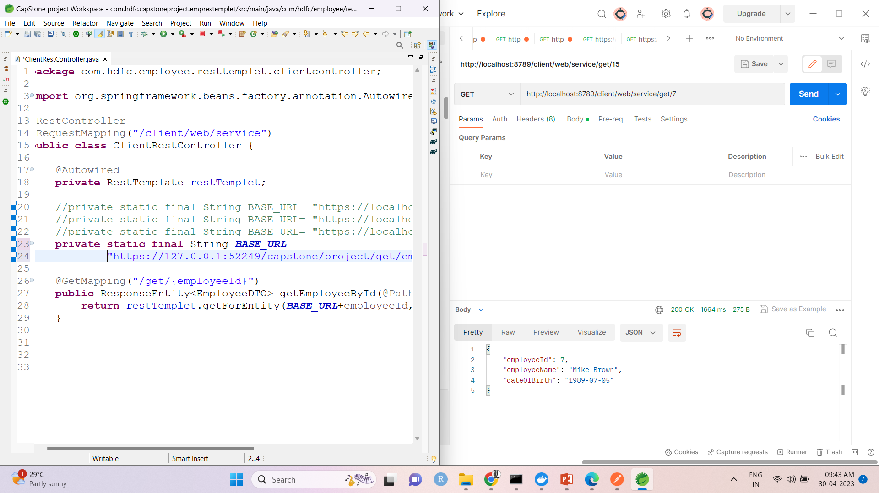
Appendices
Deploy this container on Kubernetes, with 3 instances on the container running. The same/similar client program should be utilized to call this containerized version of the web service.

